Slide 1
Iceland
14 September – 20 September 2017

Slide 2
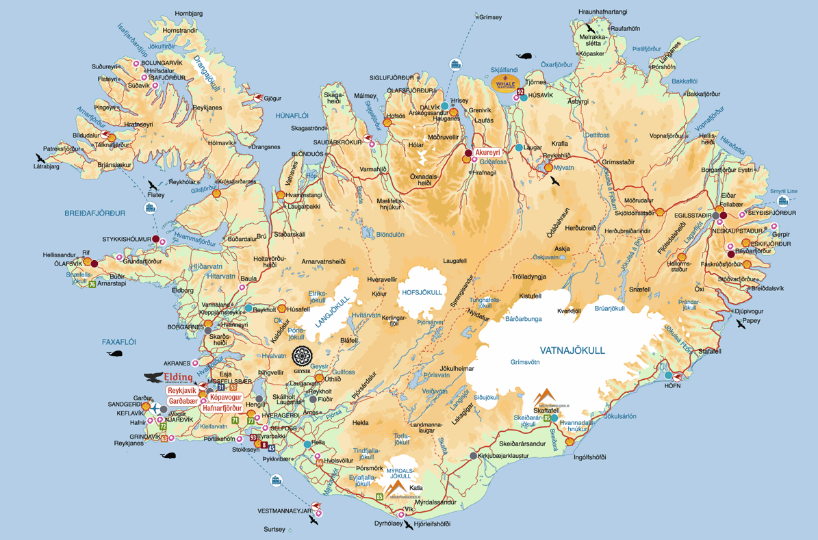

Slide 3
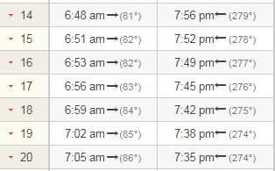
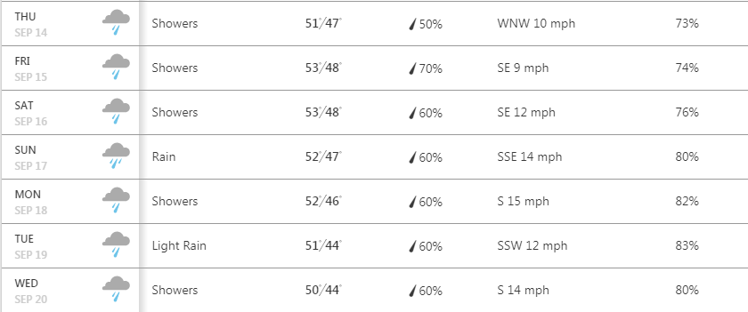
Iceland September 2017
Sunrise time and weather
sunrise - sunset
weather (Reykjavik)

Slide 4
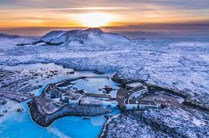
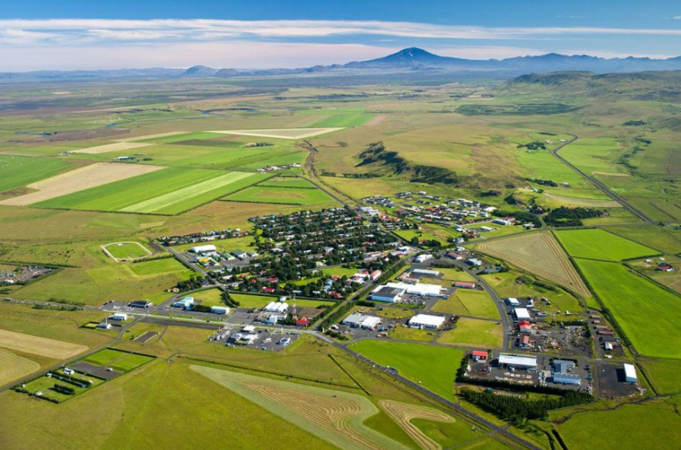
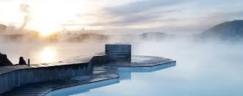
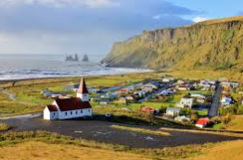
Iceland September 2017
Thursday September 14th
Itinerary
6am: arrival at Kevlavik International
7am: pick up car + drive to Blue Lagoon
8am: Blue Lagoon
11am: drive to Vik
12.30pm: pitstop at Hvolsvollur
for grocery shopping
1pm: lunch + visit Njall’s Saga museum
in Hvolsvollur
3pm: see the Black Beach/Reynisdrangar
4.30pm: drive to Skaftartunguvegur
5.30pm: stay at AirBnB “Asar”
Blue Lagoon
Hvolsvollur
Vik

Slide 5
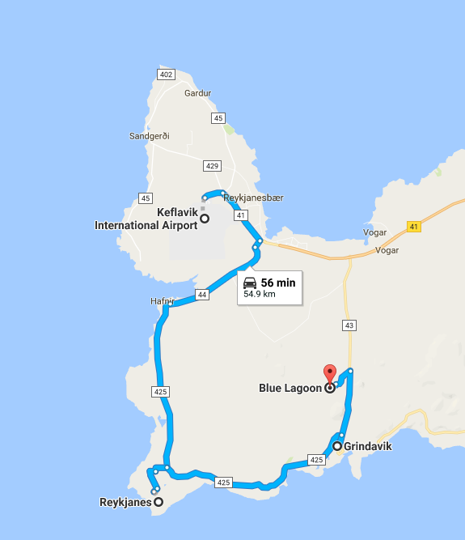
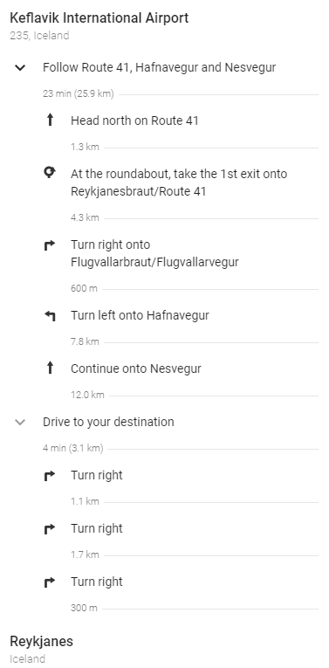
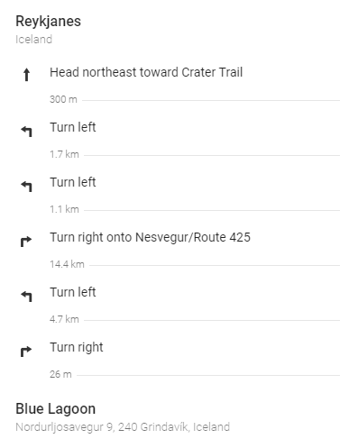

Slide 6
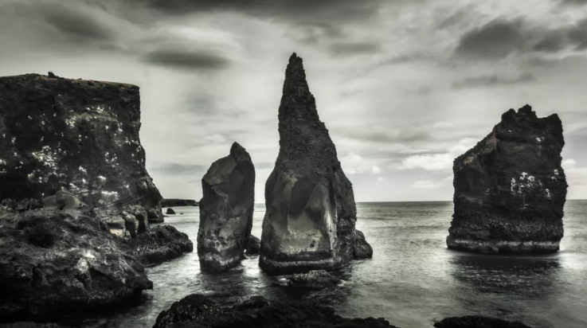
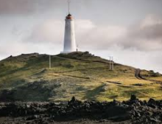
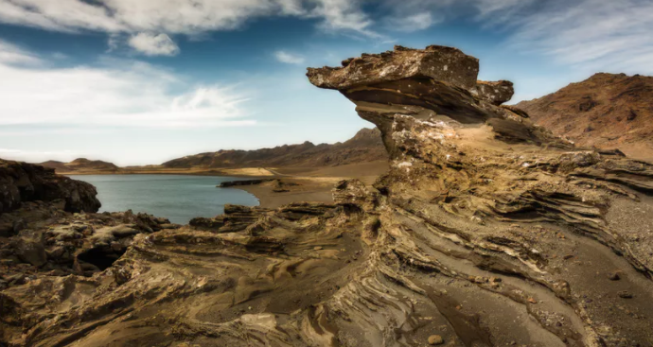
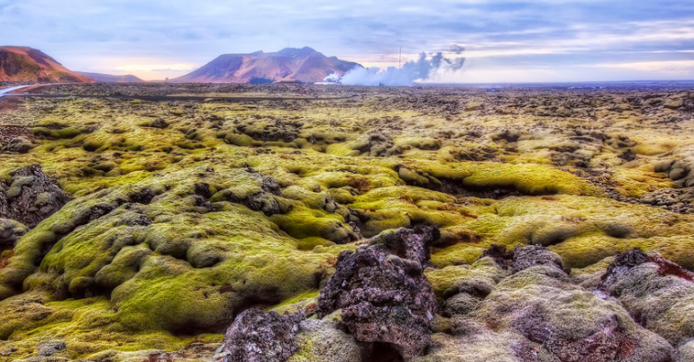
Reykjanesta
Reykjanes Lighthouse
Krysuvik
Lava Field near Grindavik

Slide 7
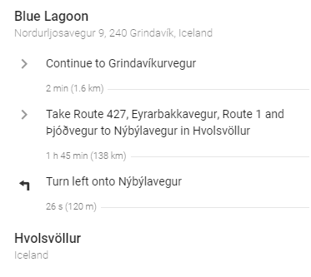
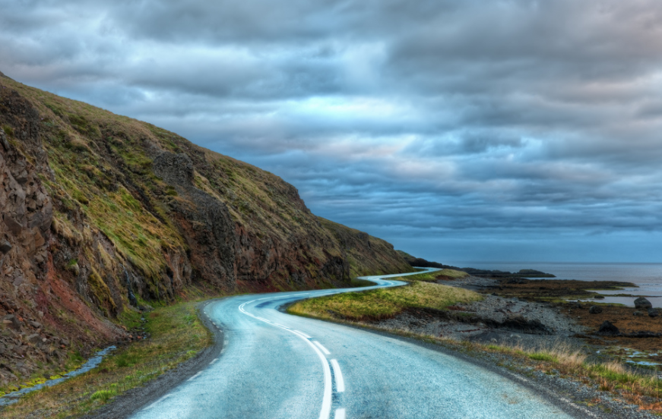
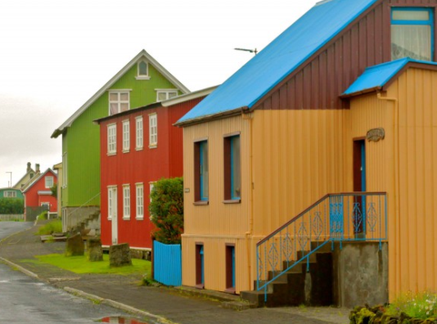
Route 427
Eyrarbakki

Slide 8
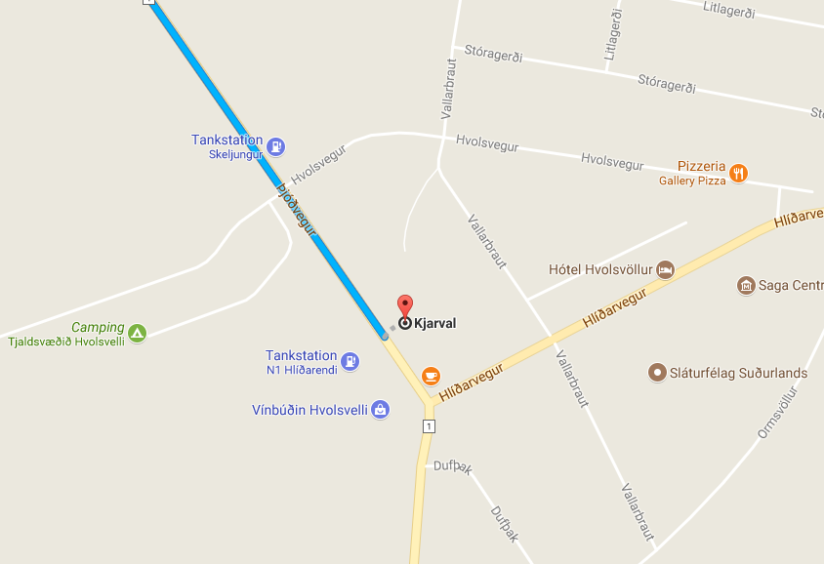
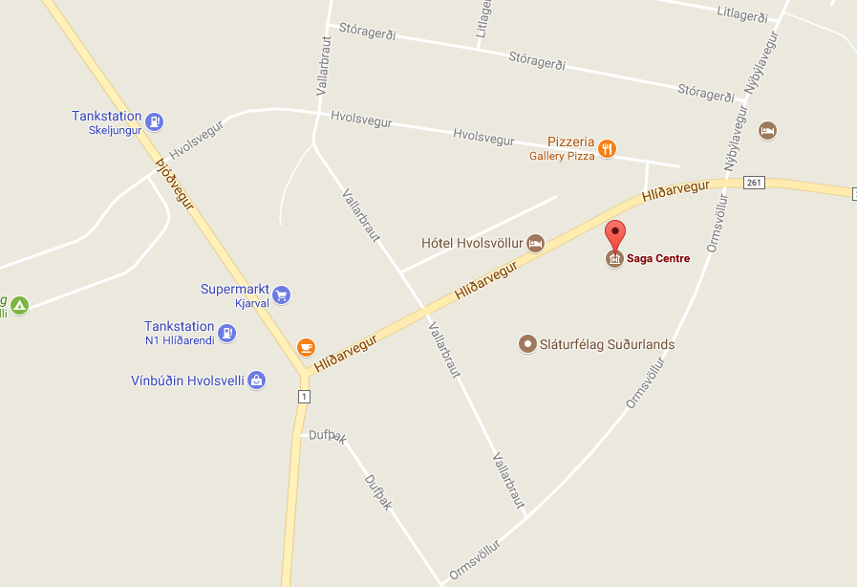
There is a grocery store “Kjarval” on the way from Blue Lagoon to Vik (about 103km or 1h19 after departure) in Hvolsvollur. It should be on Highway 1, not far after the gas station “Skeljungur”.
At the Saga Centre in Hvolsvöllur, guests are invited into a medieval world of Icelandic culture in the early centuries of Iceland’s history. The exhibition covers such subjects as ocean travel and navigation, religion, Viking cosmology, and the literary art of the sagas, Iceland’s most important contribution to world literature. Prominence is given to Njáls Saga, the masterpiece of Icelandic sagas, which takes place in the Rangárvellir region.
(Opening hours: 9am-6pm / 900 isk entry fee)

Slide 9
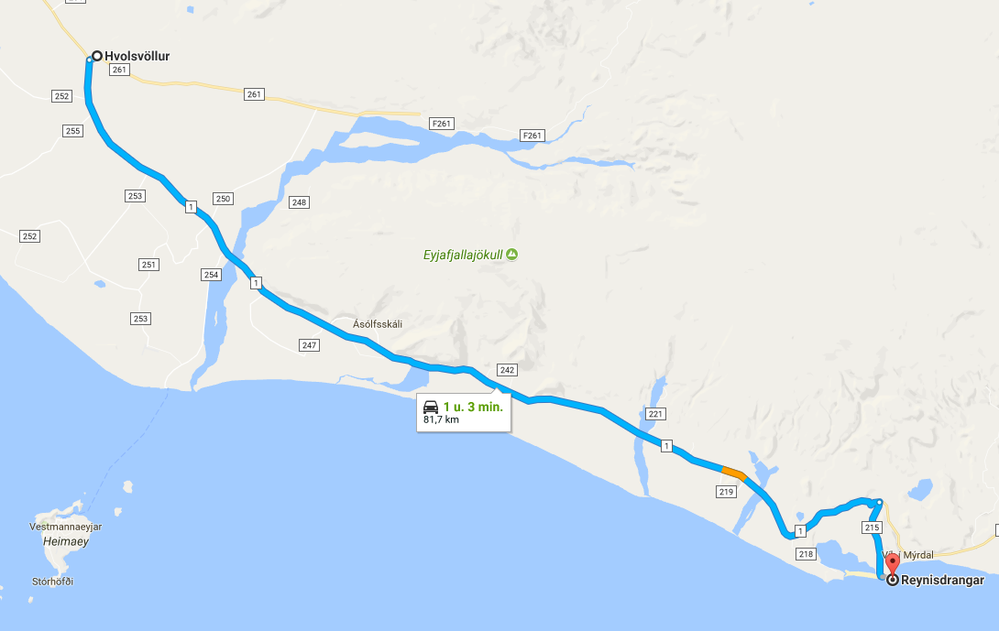
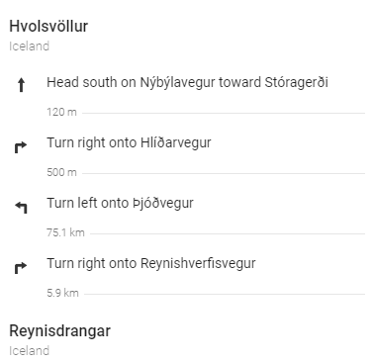

Slide 10
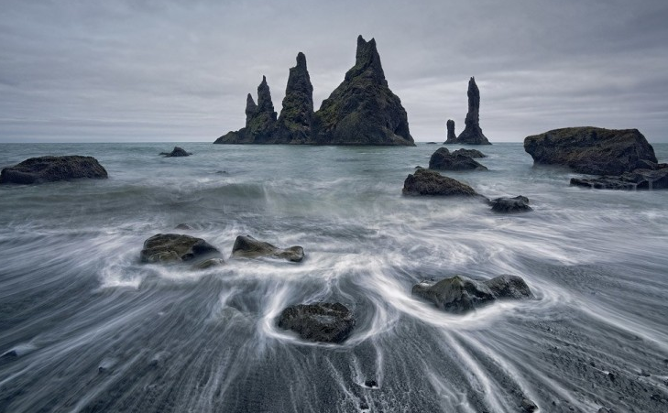
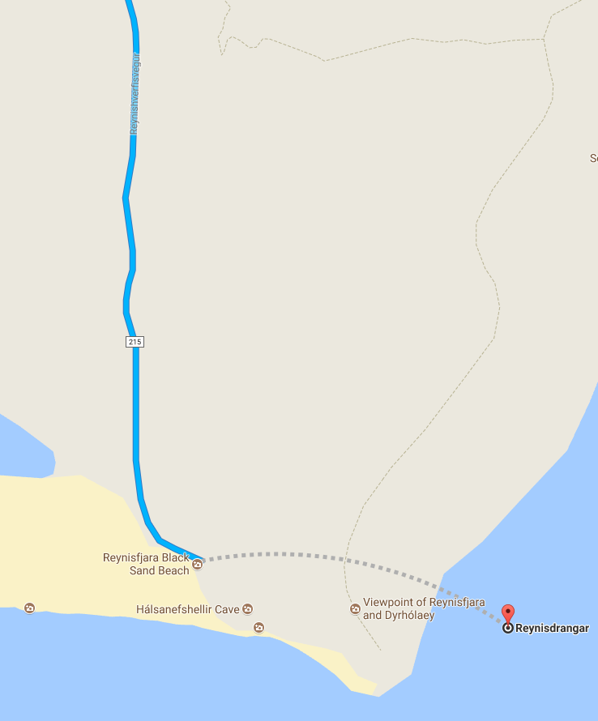
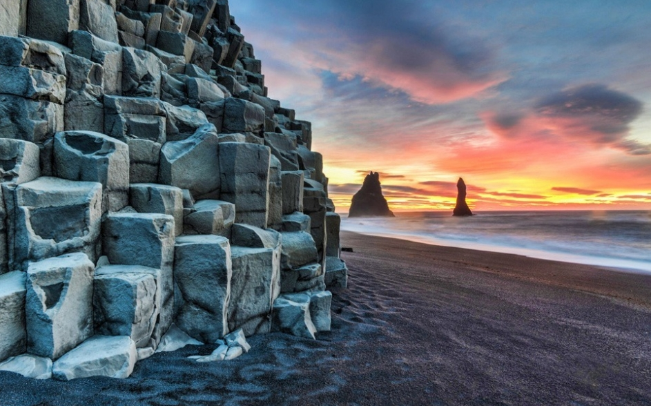
The Atlantic Ocean is quite the sculptor, much apparent in various locations around Iceland. Reynisdrangar, just south of the dramatic black beaches of Vik are three spiky basalt sea stacks rising from the ocean 66 m into the air. Legend has it that the three stacks were formerly two trolls dragging a three-mast ship towards land throughout a night. Alas, it was a slow maneuver and the night wasn't long at that time of year. At the break of dawn up rose the Sun and cast its rays on the trolls, instantly turning them into stone. The stack next to land, Landdrangur, is the fogy, Langsamur the ship is in the middle with the old hag, Háidrangur, at the rear end.

Slide 11
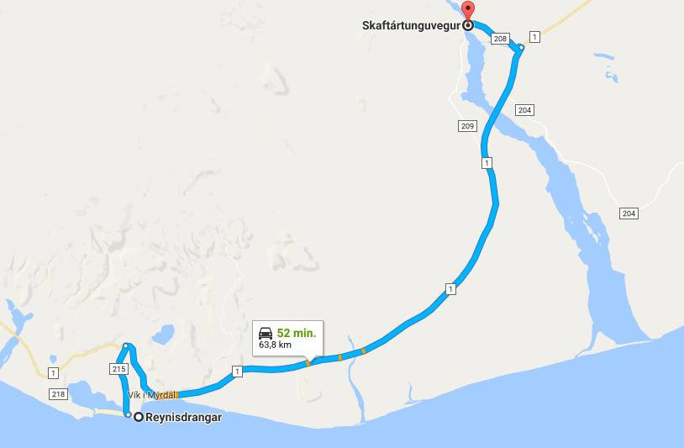
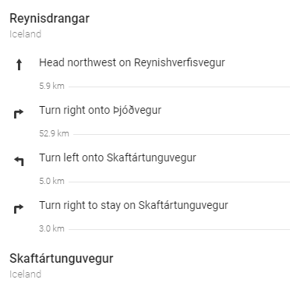

Slide 12
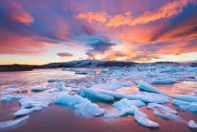
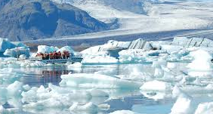
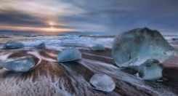
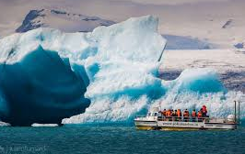
Iceland September 2017
Friday September 15th
Itinerary
8.30am: leave
9.30 am: Skaftafell Hike
1pm: Diamond Beach
3pm: Amphibian boat tour on Jokulsarlon
4.30pm: Drive back to Skartantunguvegur
Diamond Beach
Jokulsarlon
Fjallsarlon

Slide 13
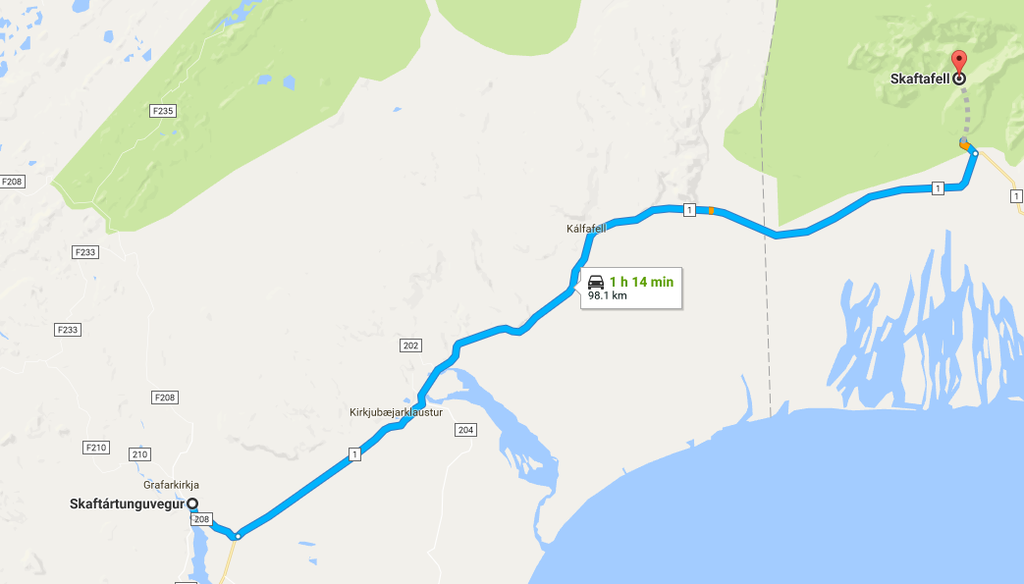
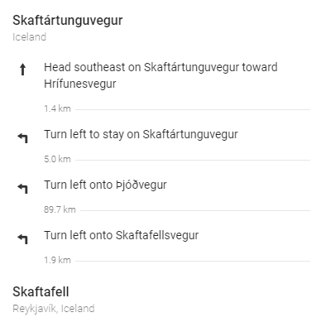

Slide 14
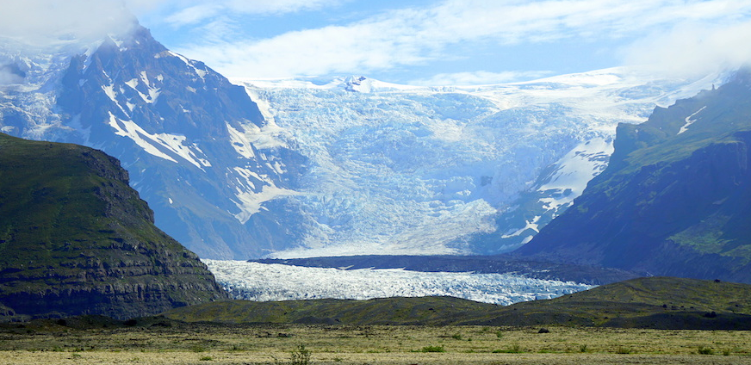
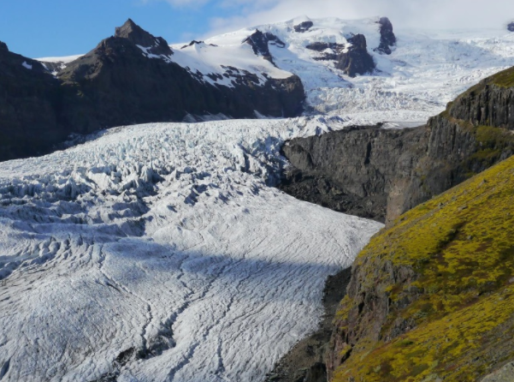
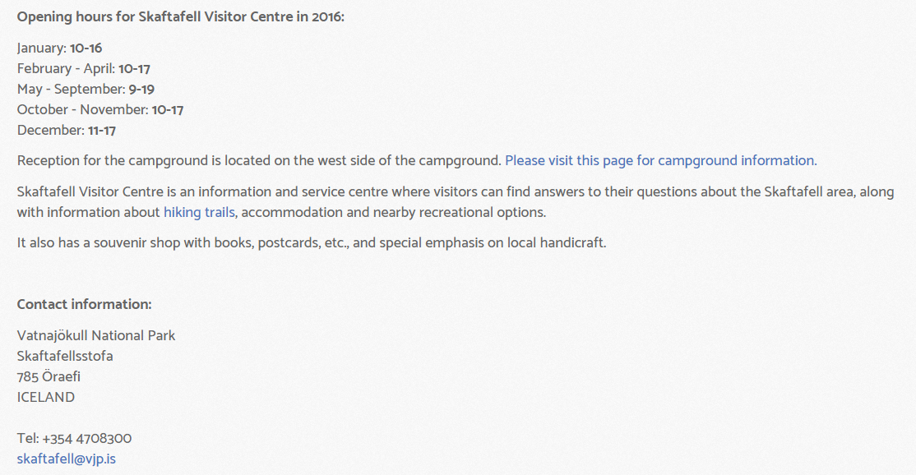
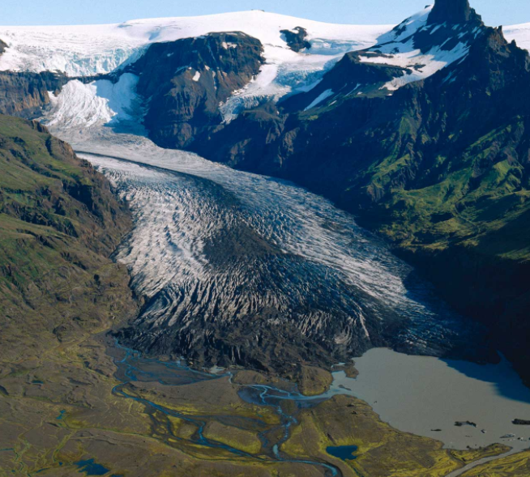
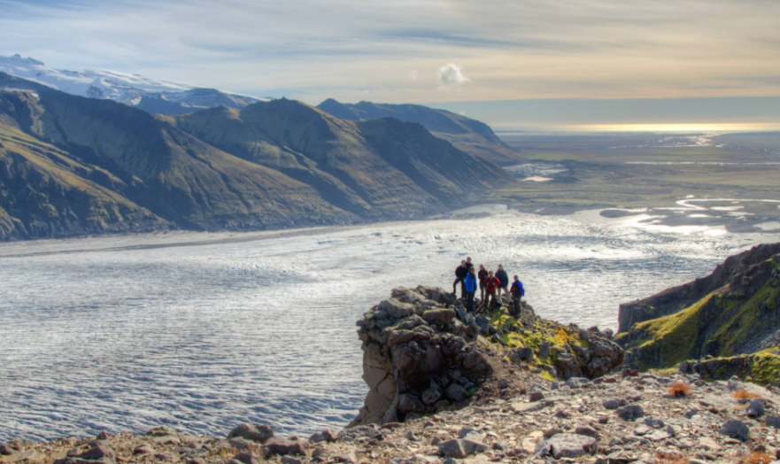
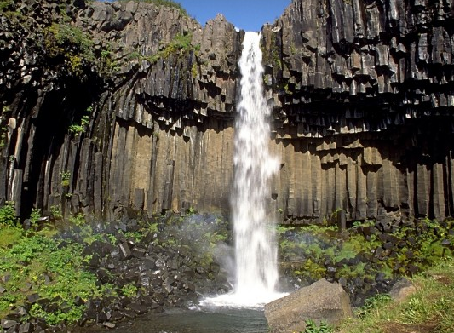
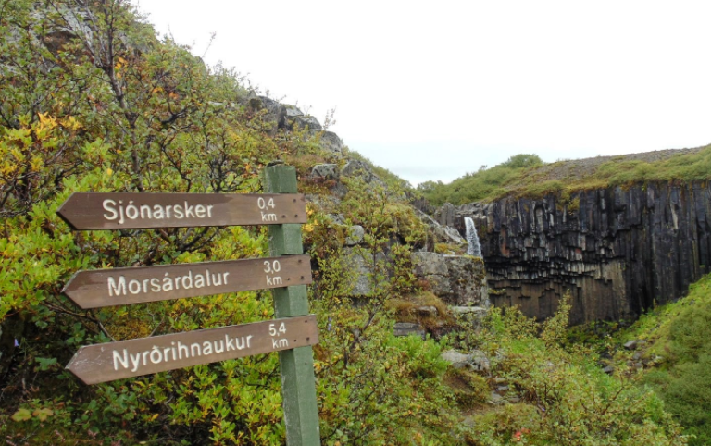

Slide 15
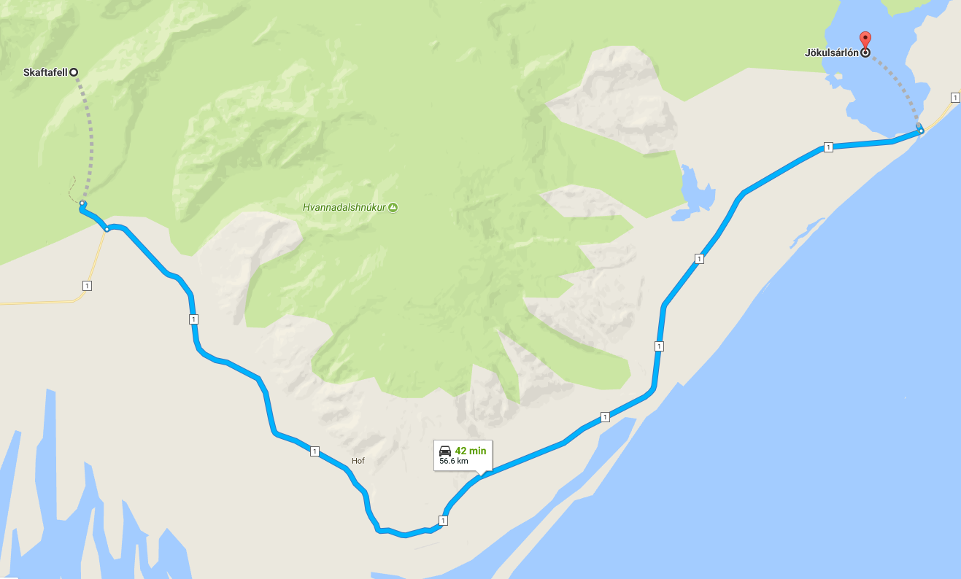
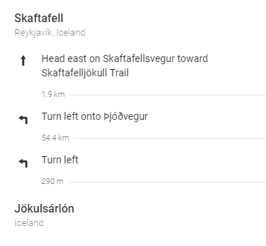

Slide 16
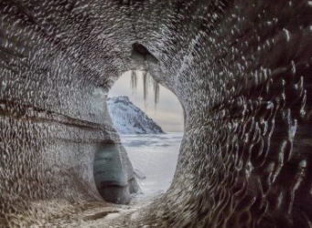
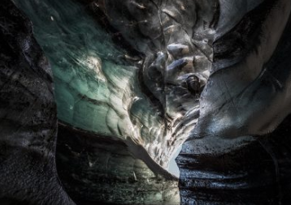
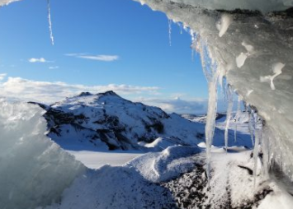
Iceland September 2017
Saturday September 16th
Itinerary
10am: Drive to Vik
11pm: Ice Cave Tour
16pm: Drive to Hvolsvollur
5pm: Stay at AirBnB

Slide 17
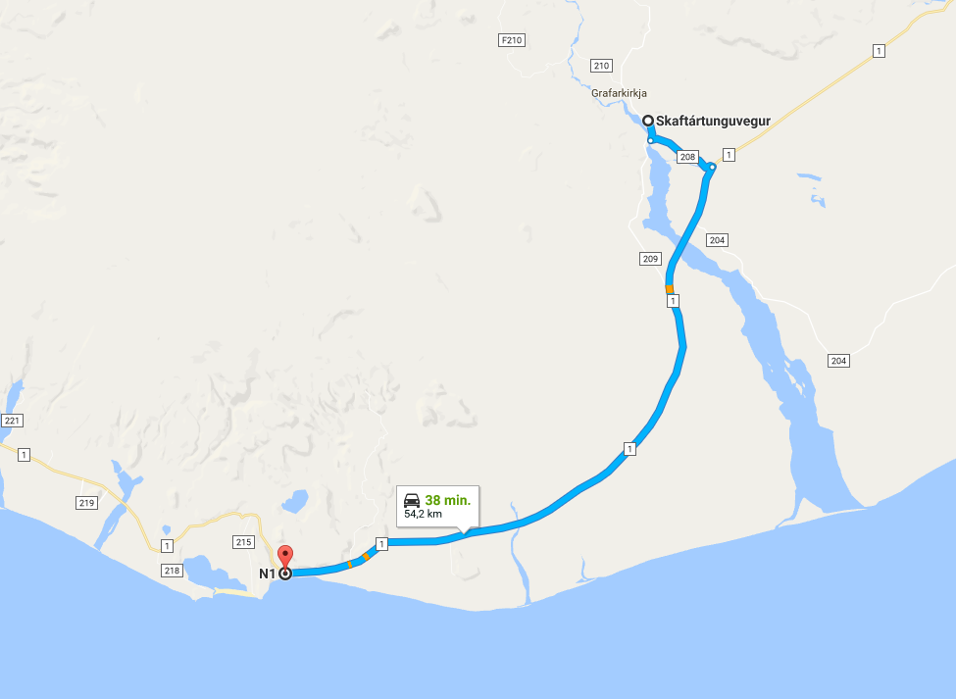
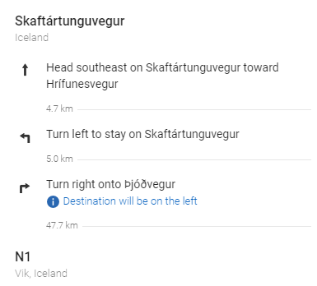

Slide 18
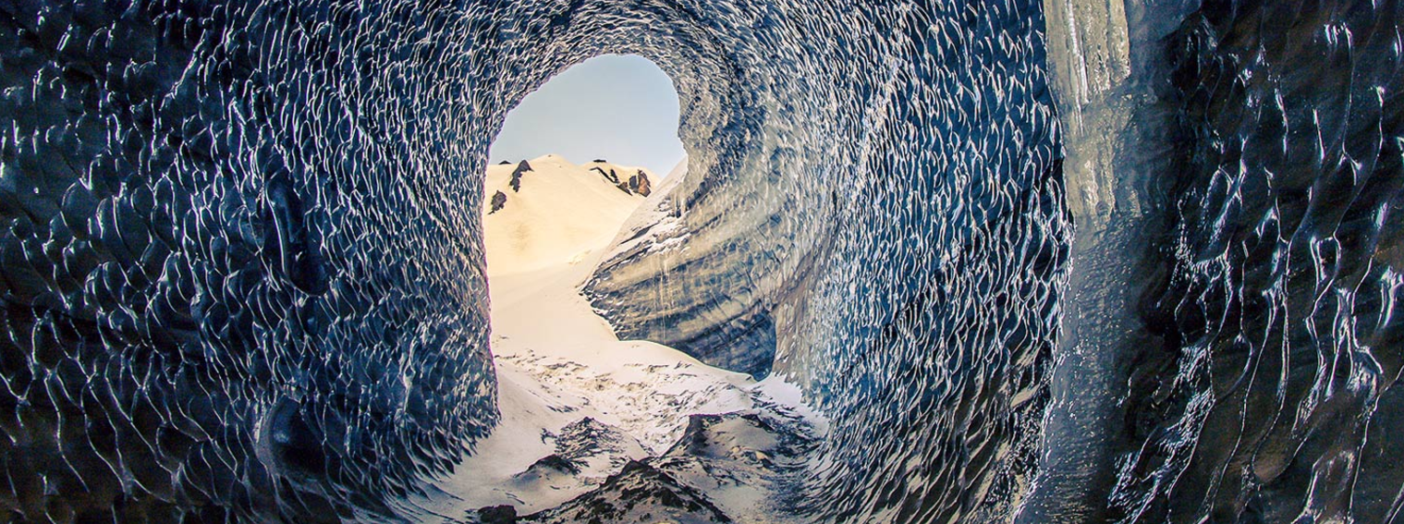
Katla Ice Cave Tour
Did you know there is a green here in Iceland that exists nowhere else in the world? It’s true and we would love to show you some of the most interestingly shaped green mountains in the highlands!
This tour will give you to the opportunity to explore and photograph those amazing mysterious mountains, but first we will explore an ice cave that dons BLUE ICE! Have you ever seen it? This amazing ice cave and glacier presents you with black, white, and BLUE ice which is over 800’s years old. This adventure is not for those who are claustrophobic (or those scared of the dark!), but most certainly for those who have and endless curiosity and exploring runs in their veins! After the journey through the green mountains a blue ice, we will find our way to explore one of Iceland’s amazing black sand dune beaches!
Safety comes always first and therefore we reserve the right to cancel the tour with short notice if the conditions are not right. We recommend you bring your warmest clothes, winter layers, gloves, hat, and camera but hiking shoes or snow boots are essential. We provide all the equipment needed so hurry up and book this amazing tour.
Departure: N1 gas station Vik

Slide 19
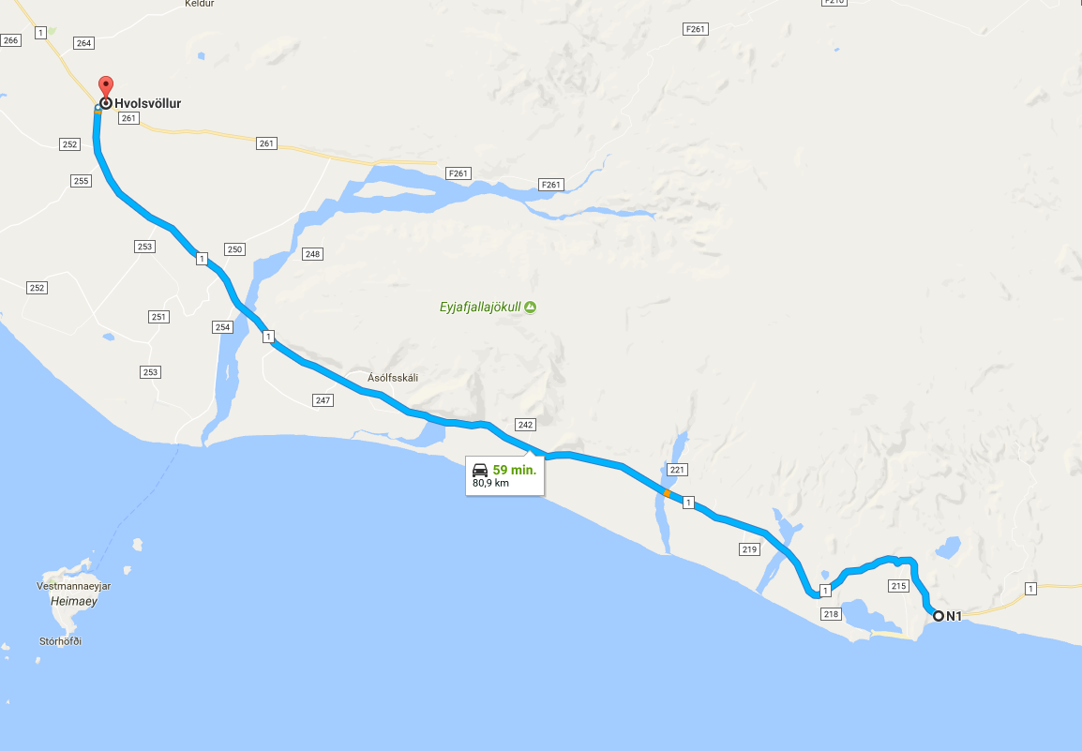
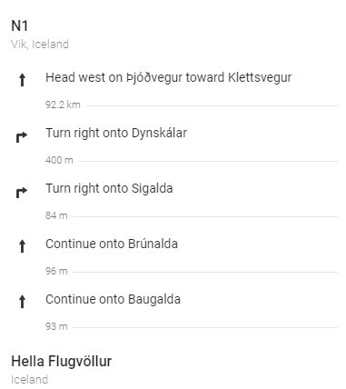

Slide 20
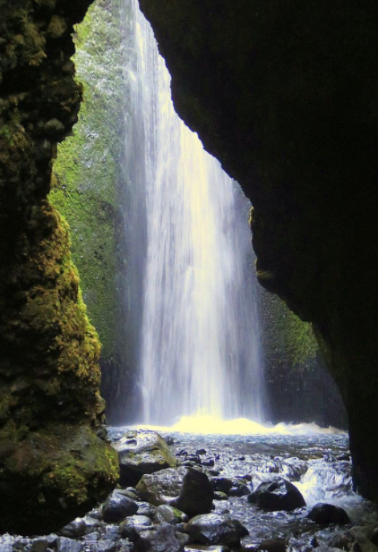
Iceland September 2017
Sunday September 17th
Itinerary
10am: leave
11am: hike Nauthusagil canyon
2pm: relax afternoon

Slide 22
Iceland September 2017
Monday September 18th
Itinerary
12pm: leave
1pm: Gulfoss waterfall
2pm: see Geysir
3pm: hike Thingvellir national park
6pm: check in at Airbnb
Thingvellir

Slide 24
The Geysir Center located at the Geysir Hot Spring Area presents information on geothermal wonders, Northern Lights, earthquakes and ice caves through a dynamic multimedia show including an earthquake simulator.
The upper half of the museum offers a sneak peek into agricultural life through a series of exhibits including video shorts on wool production as well as regional dairy processing.
A ride along the Golden Circle in the south reveals the breathtaking Gullfoss (Golden Waterfalls) where traversing a narrow path provides close-up views of the massive, two-tiered waterfall below. In winter the view is spectacular when the waterfall freezes over into undulating waves of glistening ice. On sunny days visitors are treated to thousands of rainbows, a natural reaction with the clouds of spray from the tumbling falls.

Slide 27
Iceland September 2017
Tuesday September 19th
Itinerary
11am: check-out + hike
12.45pm: leave for Reykjavik
1.30pm: check-in at AirBnb
3pm: wander around Reykjavik
Reykjavik

Slide 29
Iceland September 2017
Wednesday September 20th
Itinerary
9am: check-out + wander around Reykjavik
12.15pm: leave for Keflavik International Airport
3pm: fly back home to Chicago
Hallgrimskirkja

